Slide 1
SPACE WARRIORS

Slide 2
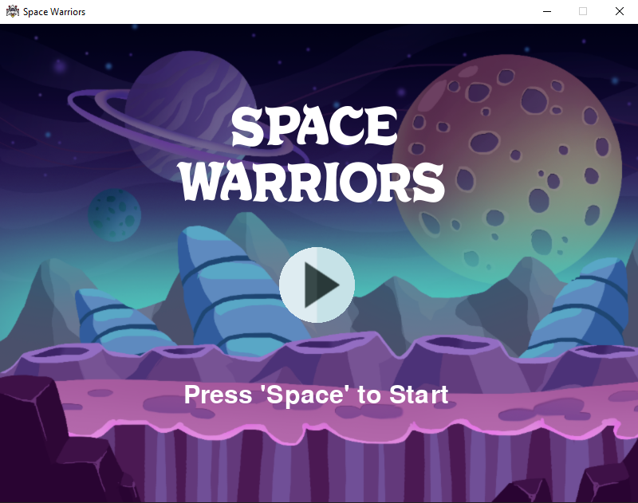
Starting Screen

Slide 3
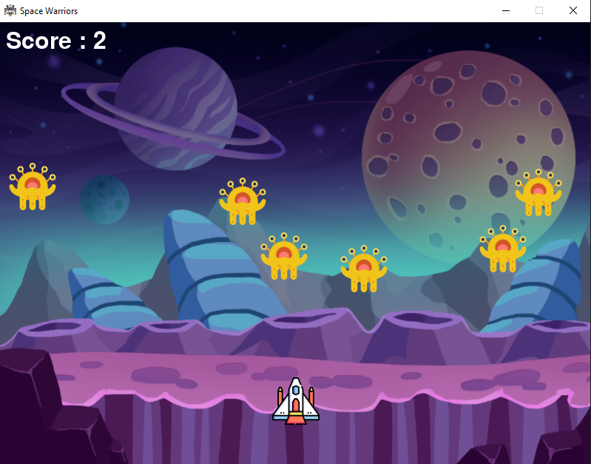
Game Screen

Slide 4
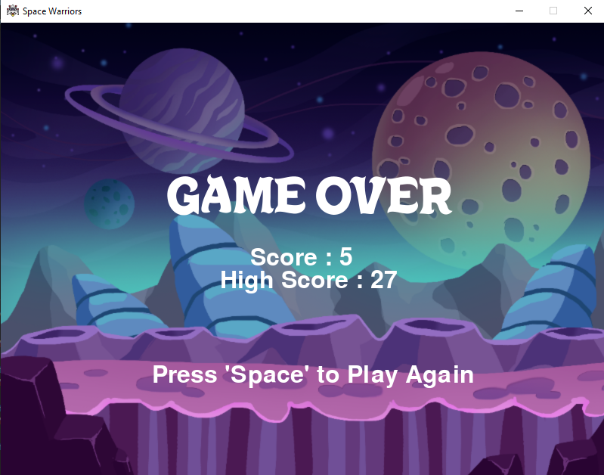
Game Over Screen

Slide 5
About the Game
You have to control a spaceship by moving in left and right directions in order to kill the enemies on the screen by shooting bullets from the spaceship.
The enemies move on the screen and try to reach you. So you have to kill them before they reach you.
When any of the enemy reach you, the game will be over!

Slide 6
Controls
Start Game – Space Key
Move Left – Left Arrow Key
Move Right – Right Arrow Key
Shoot Bullets – Space Key
Play Again – Space Key
Exit Game – Quit Button

Slide 7

Features
Made with
pygame
Uses MySQL connectivity
Use of random module

Slide 8
References
https://youtu.be/FfWpgLFMI7w
https://www.geeksforgeeks.org/introduction-to-pygame
https://www.flaticon.com
https://pngtree.com/freebackground/space-game-alien-exploration-background_1592274.html

Slide 9
Softwares Used
Editor - Visual Studio Code (VS Code)
Database - MySQL Command Line Client

Slide 10
THANK YOU!
Group Members –
Deepti Agarwal
Sneha Agarwal
Nikhil Kaushik

